Slide 1

JARVIS AI: A Discrete Structures Project
Presented by Ahmad Pervaiz
Course: Discrete Structures | University: Punjab University | Date: November 30, 2025

Slide 2

Project Overview: Unveiling JARVIS AI
What is JARVIS?
Key Features
JARVIS is an advanced AI-based intelligent voice assistant designed to seamlessly integrate with user environments. It processes human voice commands, intelligently classifies queries, automates system tasks, and fetches real-time information.
Natural Voice Interaction: Understands and responds in natural language.
Intelligent Query Classification: Routes requests efficiently.
Real-Time Data Processing: Provides instant, accurate information.
Task Automation: Executes commands to control systems.
Discrete Math Foundation: Built on robust mathematical principles.

Slide 3
Discrete Structures: The Backbone of JARVIS
JARVIS leverages several core concepts from Discrete Structures to achieve its advanced functionality, ensuring logical processing and efficient operation.
1
Decision Trees
For intelligent query routing and classification.
2
Finite State Machines
Manages system states and response cycles.
3
Graph Theory
Models application and service dependencies.
4
Boolean Logic
Critical for condition checking and decision-making.
5
Set Theory
Used for efficient query grouping and categorization.
6
Functions & Relations
Defines input-to-output mapping for commands.
7
Permutations
Ensures precise task order execution.

Slide 4

Decision Trees: The Core of Query Routing
A fundamental concept in AI, Decision Trees provide JARVIS with a structured way to interpret and act on user commands.
Root Node
Internal Nodes
Starting point for every user query.
Decision points based on query attributes.
Edges
Leaf Nodes
Represent possible outcomes or classifications.
Final actions or classified responses.
Used extensively in AI for classification and diagnostic processes.

Slide 5

Decision Tree in JARVIS: Query Routing
JARVIS employs a specialized ternary decision tree to efficiently route diverse user queries to the appropriate processing module.
Automation
Tasks to execute automatically
Real-Time
Live data or streaming needs
General
Standard informational requests
User Query
Root of routing tree
Type: Ternary Tree (3 branches per node)
Height (h): 3 levels deep, allowing for complex decision paths.
Branching Factor (b): 3, indicating the number of possible outcomes at each decision point.
Maximum Paths: bh = 33 = 27 potential routes for user queries, demonstrating its robust routing capability.

Slide 6
Decision Trees: Discrete Mathematics Definition
From a Discrete Mathematics perspective, JARVIS's decision tree embodies key concepts from Tree Theory and Algorithms.
Vertices (Nodes)
Edges
Each point represents a query or a specific decision criteria JARVIS evaluates.
These are the conditional links that guide the query's path based on JARVIS's analysis.
Leaf Nodes
Root
Represent the final, actionable outcomes after all decisions have been made.
The initial processing of the user's input, the starting point of the decision flow.
This structured approach ensures deterministic and predictable query processing, highlighting the application of advanced algorithms in AI.

Slide 7
Decision Tree: Simplified Code Idea
The logic of JARVIS's decision tree can be conceptualized through a simple conditional structure, where each 'if' statement mirrors a tree node and each 'return' signifies a leaf action.
def decide_query_type(query): if is_general(query): return "general" elif is_real_time(query): return "real_time" else: return "automation"
Each if condition acts as a branching tree node, directing the flow. Each return statement represents a leaf action, triggering a specific JARVIS module. This conceptual code demonstrates how discrete logical paths are implemented to classify user intents.

Slide 8





Finite State Machines (FSM): Managing JARVIS's Workflow
Finite State Machines are crucial for managing JARVIS's dynamic behavior, allowing it to transition smoothly between different operational modes based on user interaction and internal events.
Listening
Idle
Actively capturing user input.
Waiting for activation.
Processing
Analyzing and classifying the query.
Error
Handling unexpected situations.
Speaking
Delivering the response to the user.
These states and transitions are formalized as FSM=(Q,I,Z,δ,W), ensuring predictable system behavior.

Slide 9
FSM in JARVIS: Operational Cycle
JARVIS's FSM orchestrates the system's response cycle, from initial user input to final action, ensuring a coherent and logical user experience.
System States (Q)
Q = {Idle, Listening, Processing, Speaking, Error}
Inputs (I)
I = {start, query, done, error, reset}
Example Transition:
Idle → Listening → Processing → Speaking → Idle
This cyclical process is vital for managing voice activation, query interpretation, and generating appropriate responses, forming the core of JARVIS's interactive capabilities.

Slide 10

Graph Theory: Managing Dependencies
Graph Theory in JARVIS is vital for modeling and managing complex software dependencies, ensuring that different applications and services interact seamlessly.
Graph G = (V, E)
Vertices (V): Represent individual applications or services within JARVIS's ecosystem.
Edges (E): Illustrate the dependency links between these components.
Graph Type: Directed Acyclic Graph (DAG) – ensuring no circular dependencies, preventing system deadlocks.
With |V|=7 (e.g., Speech Recognition, NLU, Task Executor, etc.) and |E| ≥ 6, this structure guarantees efficient and reliable operation for managing software dependencies and execution flow.

Slide 11
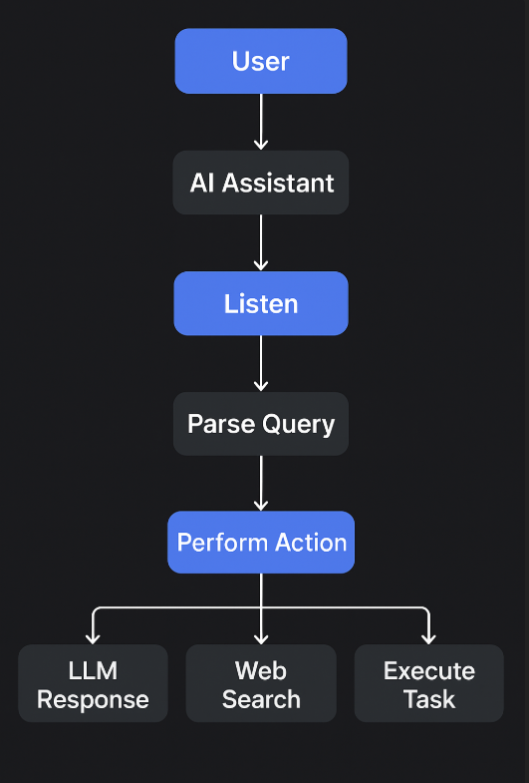

Slide 12
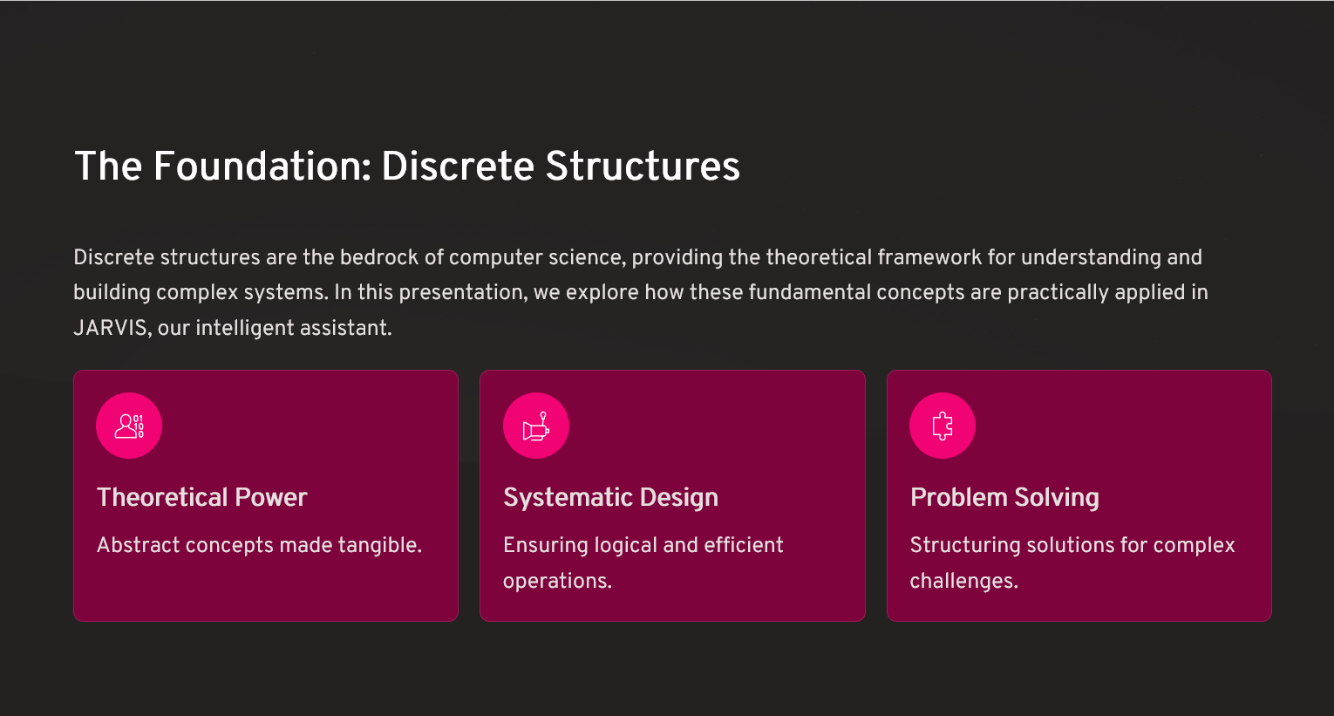

Slide 13
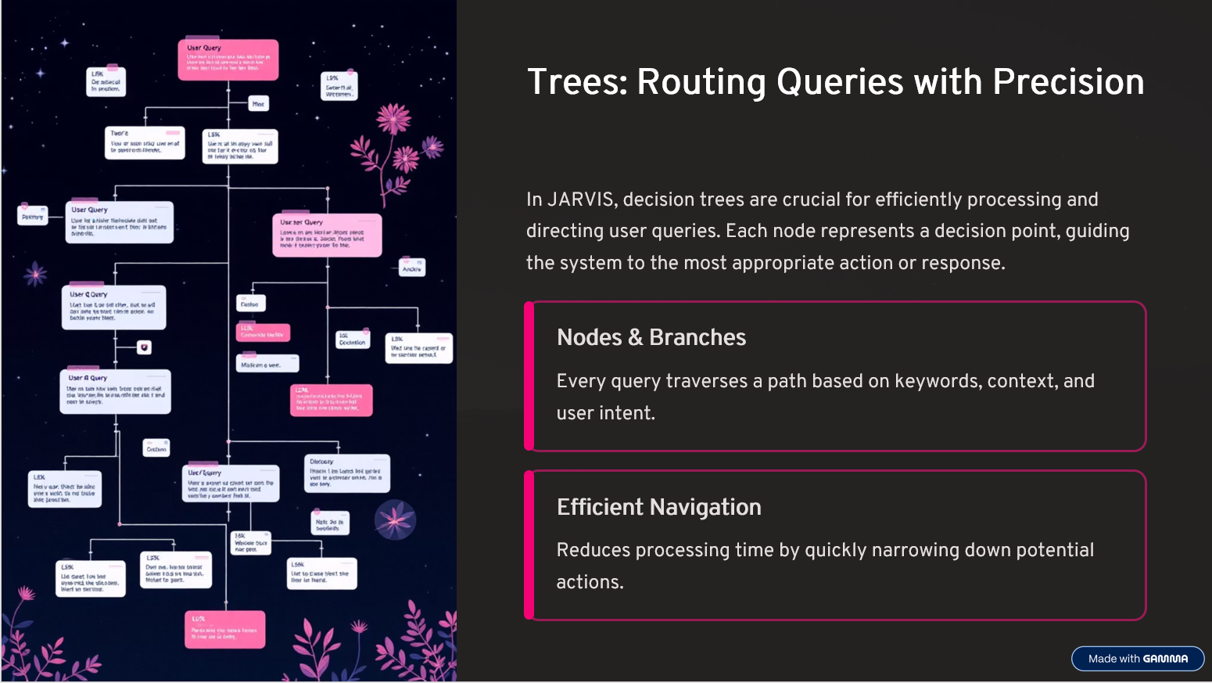

Slide 14
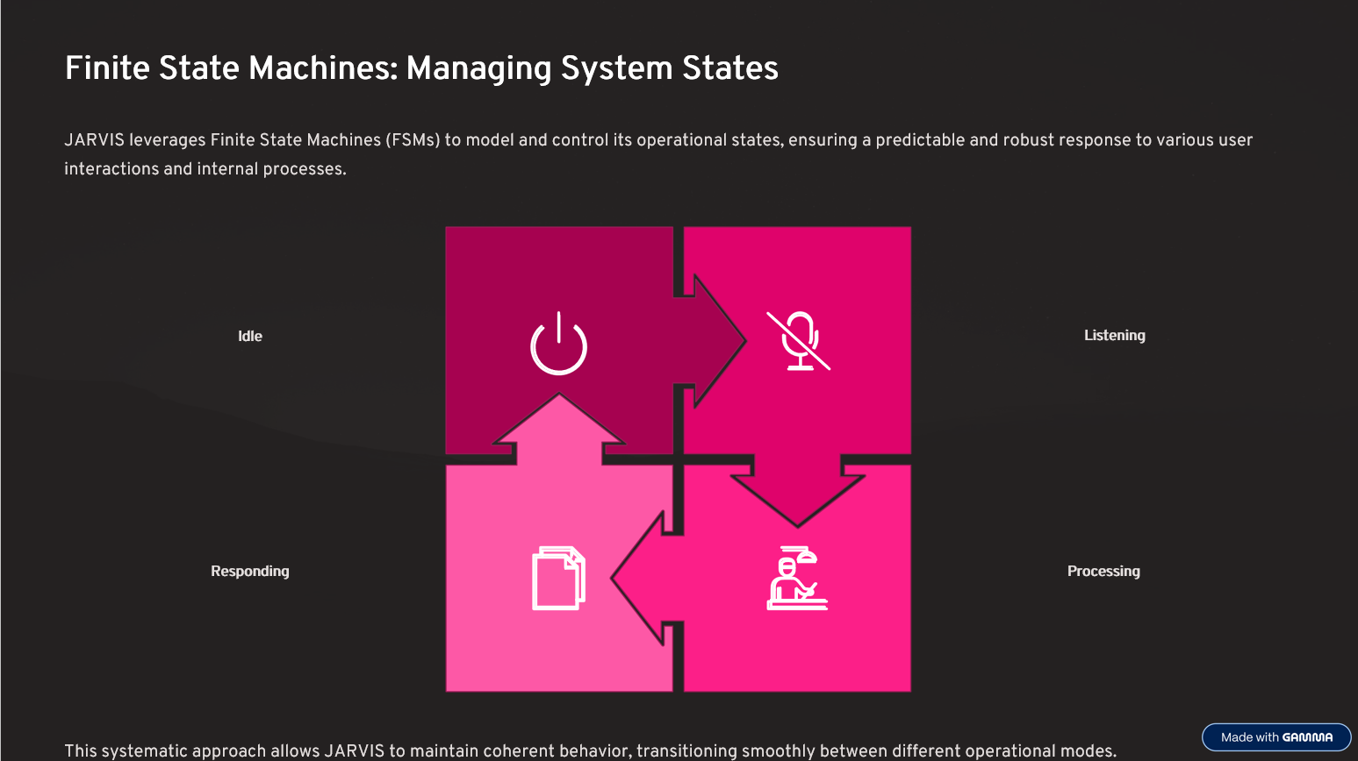

Slide 15
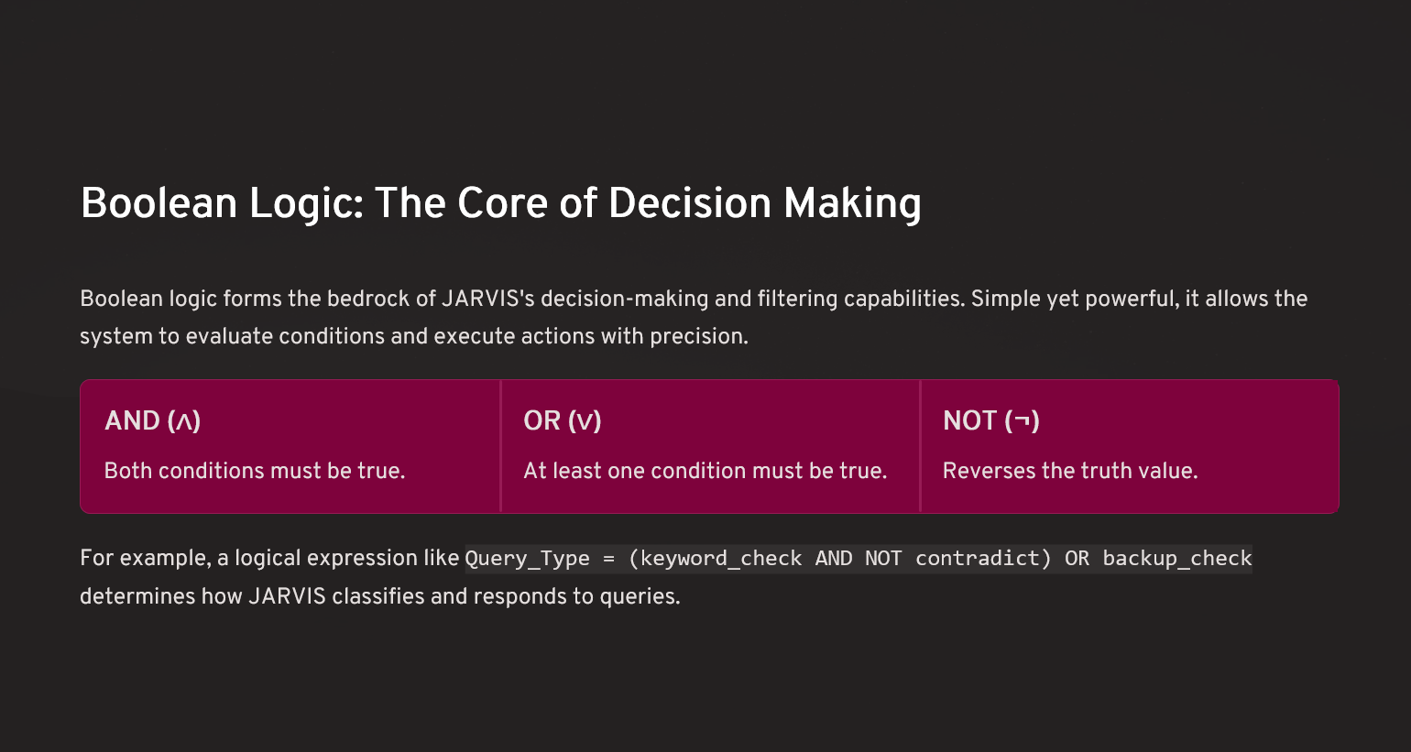

Slide 16
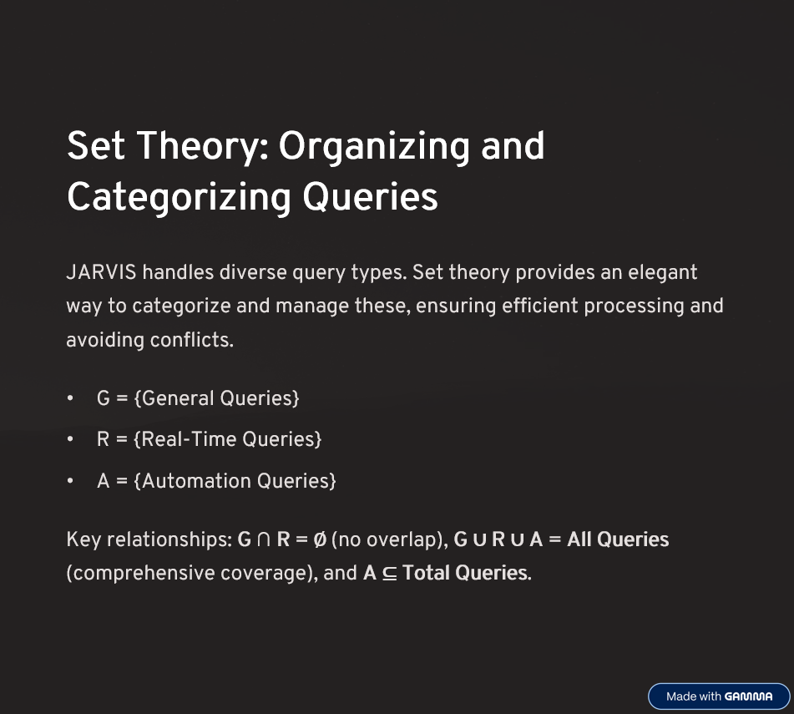

Slide 17
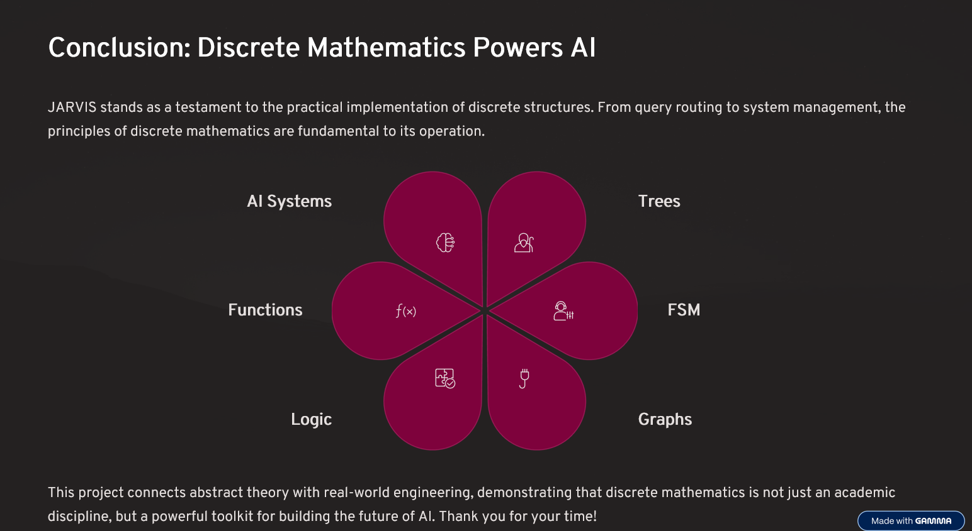

Slide 18
Thank You !
Any Question ?

